Slide 1
2021 VIRTUAL Spring cOMPETITION
CATEGORY WINNERS
MOST PROMISING NOVICE
BEST IN SHOW

Slide 2
Nb of Entries
We received a total of 52 entries from 28 members:
Novice Small 6
Novice Large 6
Intermediate Small 2
Intermediate Large 5
Open Small 6
Open Large 21
Segmented 6

Slide 3
Nb of Votes
A total of 47 members voted but there were from 1 to 4 abstentions in some categories.
Winners for whom there are no picture are invited to send one to mal4.ms.ghwg@gmail.com.
Some pictures were copied from the GHWG website and are blurry. These winners are also invited to send new ones to the same address.

Slide 4
Novice SMALL

Slide 5
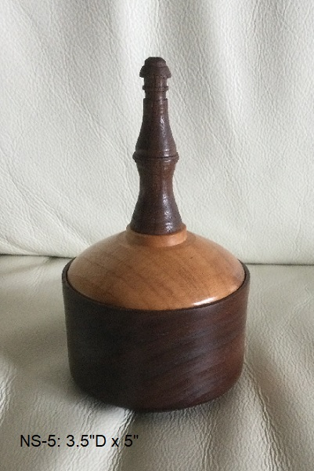
3rd
Box with finial
Walnut with Ambrosia maple lid
Tung oil
Gary Morphet

Slide 6
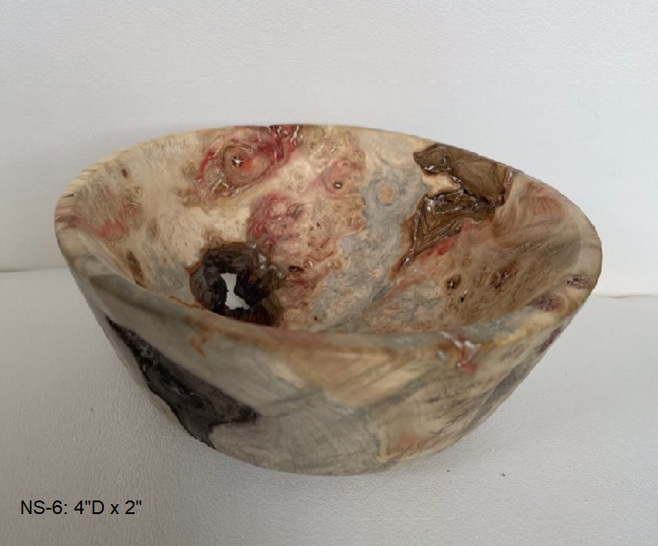
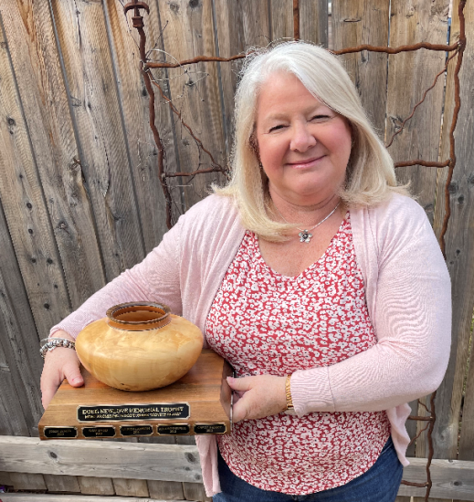
2nd
Bowl
Manitoba maple burl
Hampshire Sheen
Suzanne Wood

Slide 7
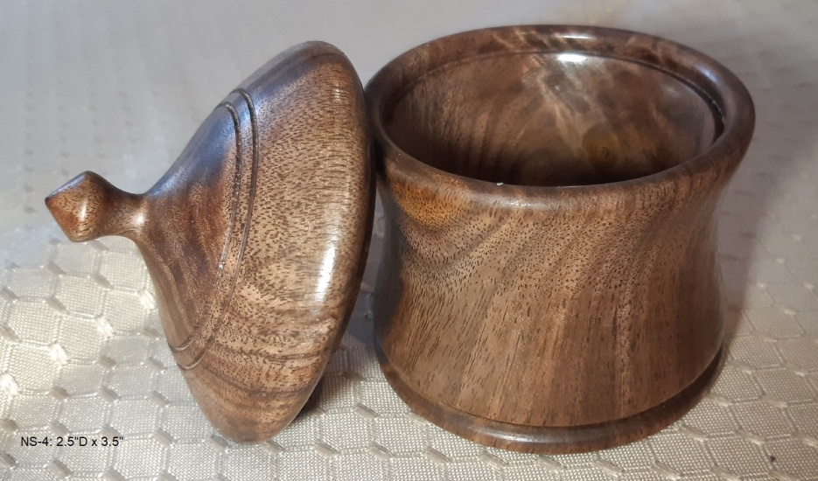
1st
Lidded box
Walnut
Shellawax
Scott Tipping

Slide 8
Novice LARGE

Slide 9
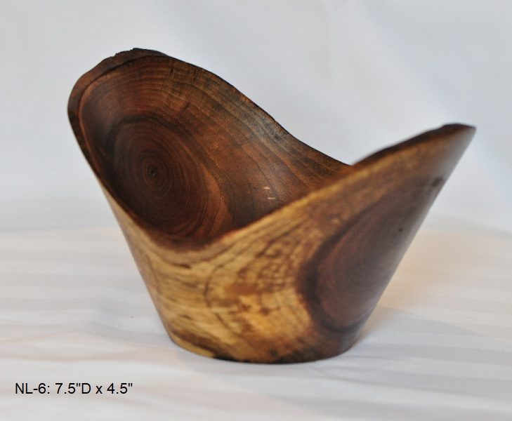
3rd
“Wings”
Live edge bowl
Black walnut
Odie’s oil
Rob Peachy

Slide 10
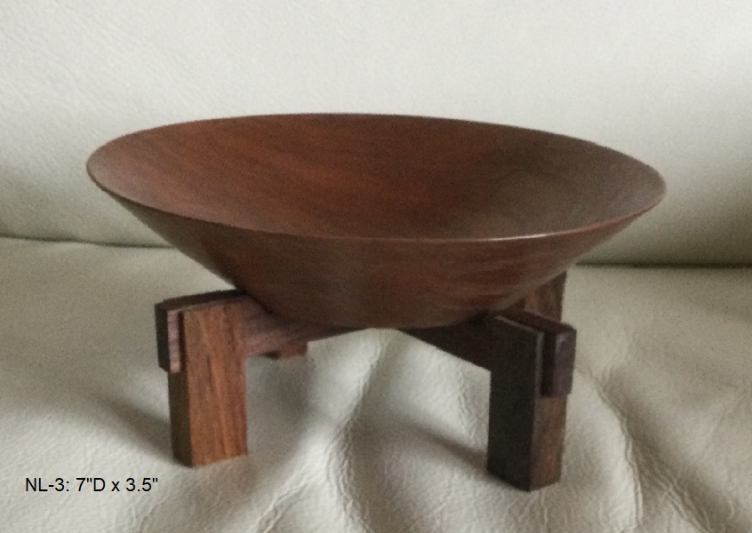
2nd
Bowl on stand
Cherry on walnut
Tung oil
Gary Morphet

Slide 11
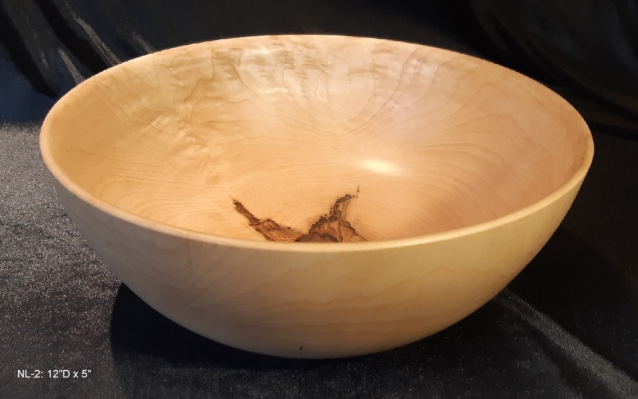
1st
“Chatoyance Starburst”
Bowl
Partially quilted maple
Odie’s oil and butter
Scott Tipping

Slide 12
INTERMEDIATE SMALL
(Only 2 entries so no 3rd place)

Slide 13
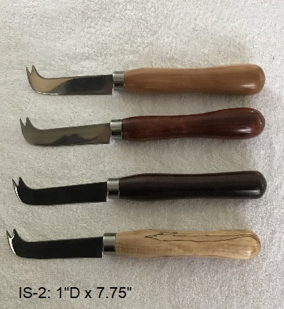
2nd
Cheese knives
Apple, bubinga, Indian rosewood & spalted beech
CA glue
Rick Ferris

Slide 14
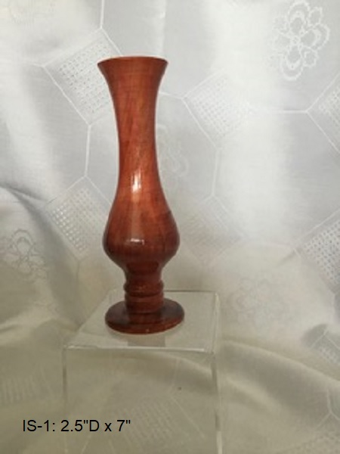
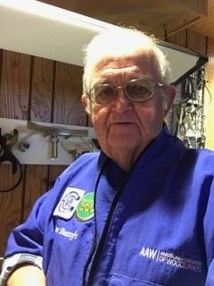
1st
Vase
Manitoba maple
Chestnut spirit stains, wipe-on poly
Brent Beacroft

Slide 15
INTERMEDIATE LARGE

Slide 16
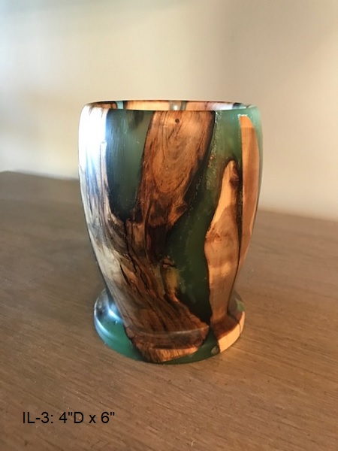
3rd
Vase
Driftwood & epoxy
Wax
Gary Kirkwood

Slide 17
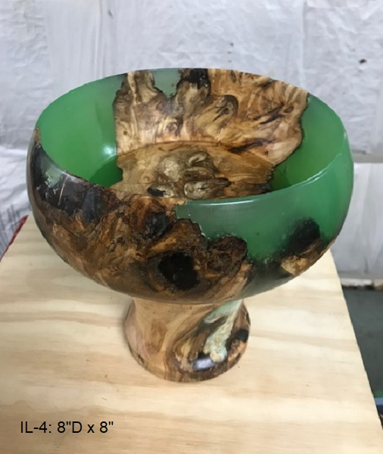
2nd
Pedestal bowl
Driftwood & epoxy
Wax
Gary Kirkwood

Slide 18
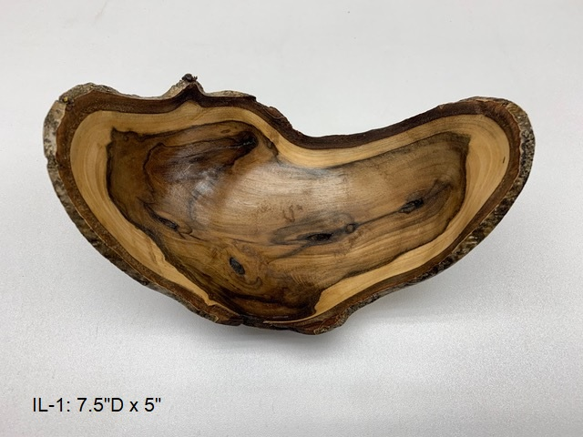
1st
“First Time”
Live edge bowl
Black walnut
Clear shellac
John Pegg

Slide 19
OPEN SMALL

Slide 20
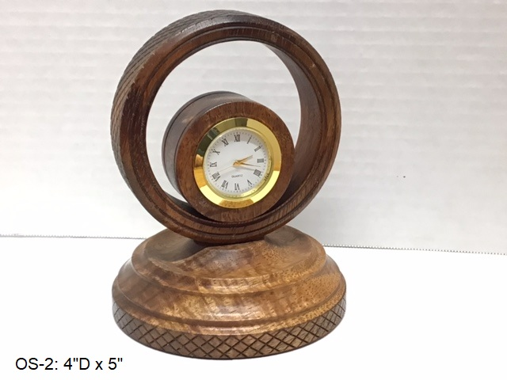
3rd
Desk clock
Koa
Hampshire Sheen
Keith Robinson

Slide 21
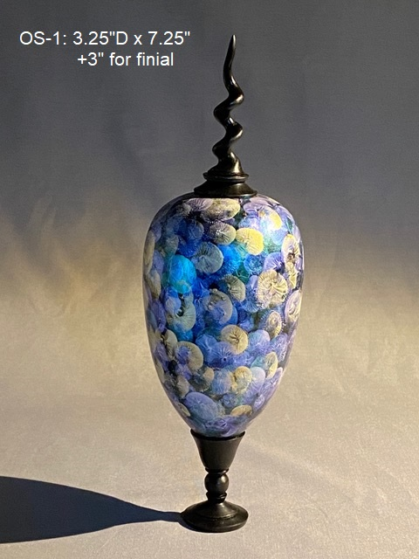
2nd
Pet cremation urn
Red elm & African blackwood
Golden interference paints & wipe-on poly
David Senecal

Slide 22
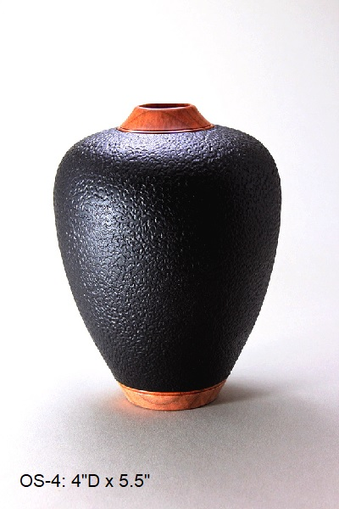
1st
Hollow form
Maple
Ink & nitrocellulose lacquer
Malcolm Cumming

Slide 23
OPEN LARGE

Slide 24
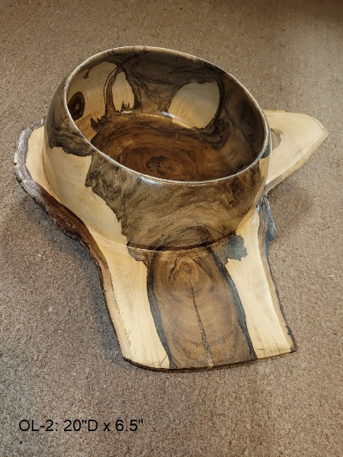
3rd (tie)
“Saturn bowl”
Bowl with wings
English walnut
Tung oil
Don Svob

Slide 25
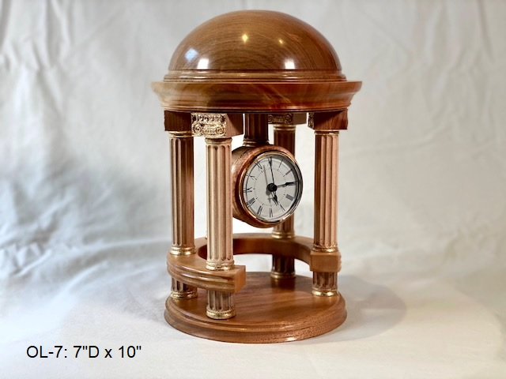
3rd (tie)
“The Roman Ionic Clock”
Mantle clock
Maple
Hampshire Sheen
Keith Robinson

Slide 26
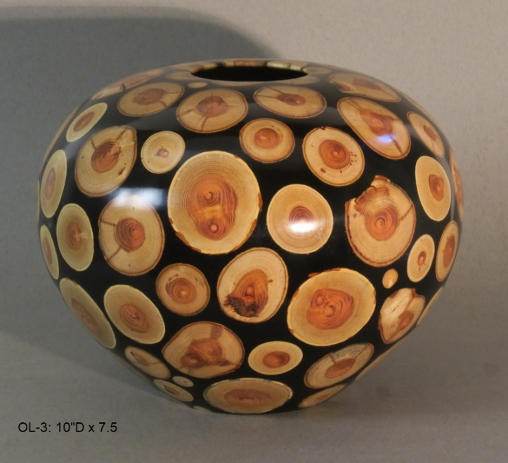
2nd
“A Swarm of Locust”
Hollow form
Honey locust & epoxy
Mylands High Build Friction Polish, buffed
Maurice Solar

Slide 27
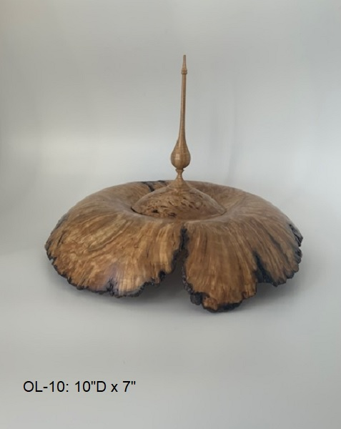
1st
“Overflowing”
Box with finial
Ash burl
Semi-gloss Minwax
Charles Jordan

Slide 28
SEGMENTED

Slide 29
3rd
Gerry Bell
“Spiral basket illusion”
Vase
Poplar
Pyrography, Staedtler makers, wipe-on poly

Slide 30
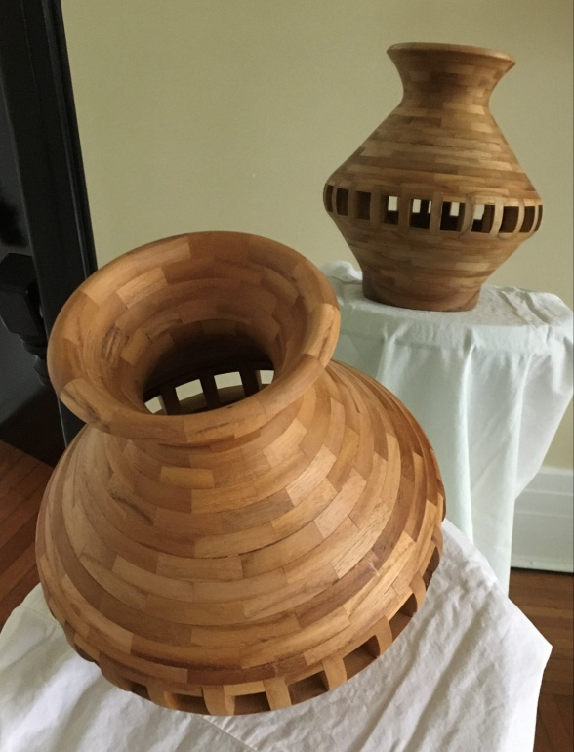
2nd
Hollow vessel
Teak
Walnut oil
John Bender

Slide 31
1st
Maurice Solar
“Let’s be Polite”
Vase
Toasted maples, mahogany & sycamore
Mylands High Build Friction Polish, buffed

Slide 32
MOST PROMISING NOVICE

Slide 33
Scott Tipping
“Chatoyance Starburst”
Bowl
Partially quilted maple
Odie’s oil and butter

Slide 34
BEST IN SHOW

Slide 35
“A Swarm of Locust”
Hollow form
Honey locust & epoxy
Mylands High Build Friction Polish, buffed
Maurice Solar

