Slide 1
2023 Spring cOMPETITION
June 15, 2023
Exotic Woods
Burlington

Slide 2
Nb of Entries
We received a total of 44 entries from 29 members:
Novice Small 4
Novice Large 8
Intermediate Small 3
Intermediate Large 8
Open Small 8
Open Large 11
Segmented 2

Slide 3
Novice SMALL

Slide 4
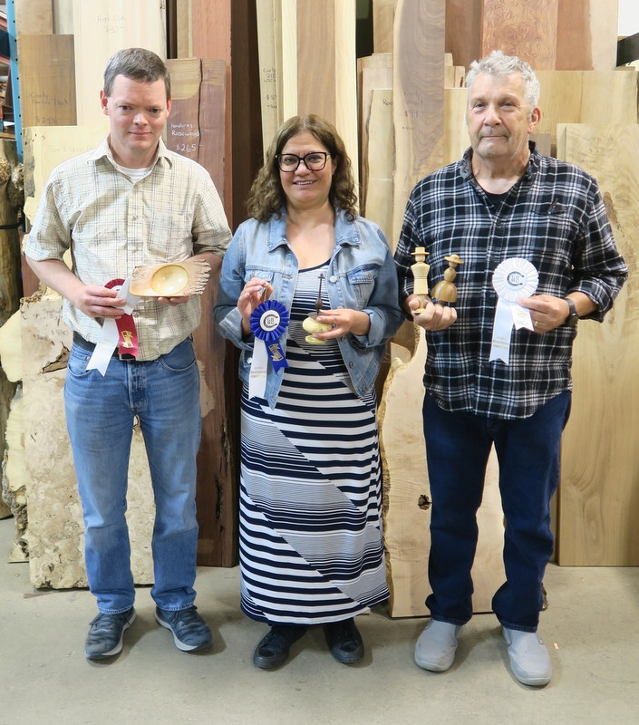
1st : James Mitchell
2nd Ladan Khodrang – 3rd : Wayne Heil

Slide 5
Novice LARGE

Slide 6
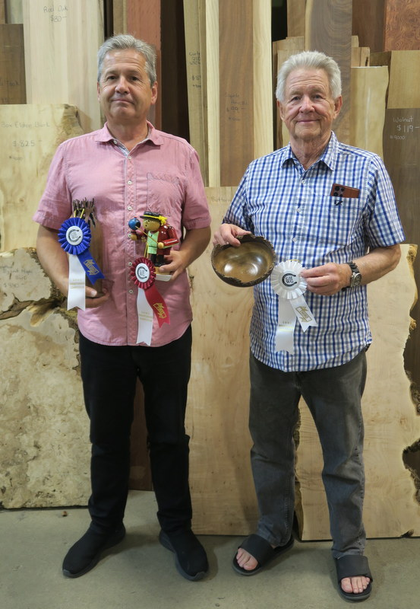
1st & 2nd : Ed Erl
3rd : Iain Douglas

Slide 7
INTERMEDIATE SMALL

Slide 8
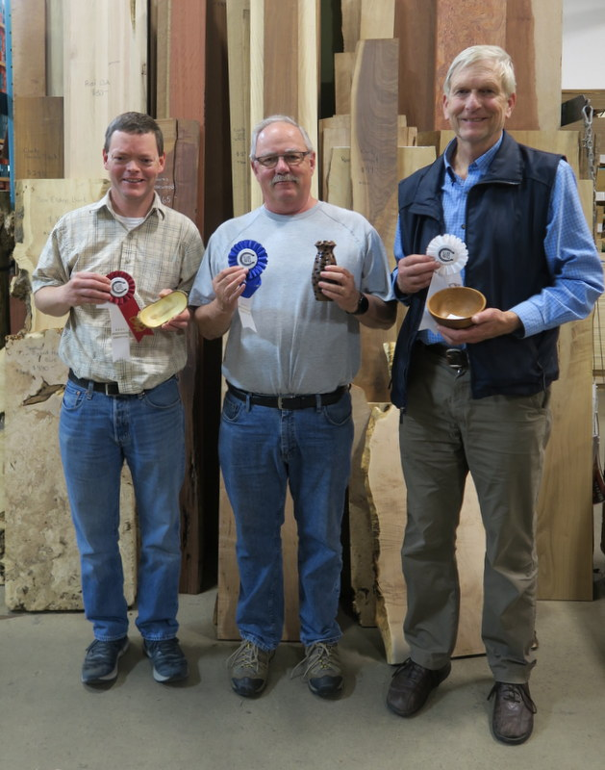
1st : James Mitchell
2nd : Pat Moran– 3rd : Neil Dunning

Slide 9
INTERMEDIATE LARGE

Slide 10
1st : James Mitchell
2nd : Scott Tipping – 3rd : Gwyn Parry

Slide 11
OPEN SMALL

Slide 12
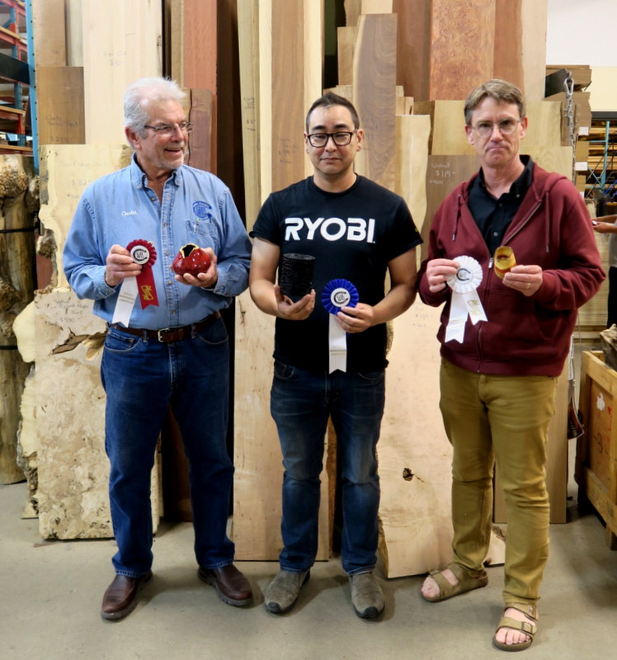
1st : Charles Jordan
2nd : Chris Sisson – 3rd : Everett Vander Horst

Slide 13
OPEN LARGE

Slide 14
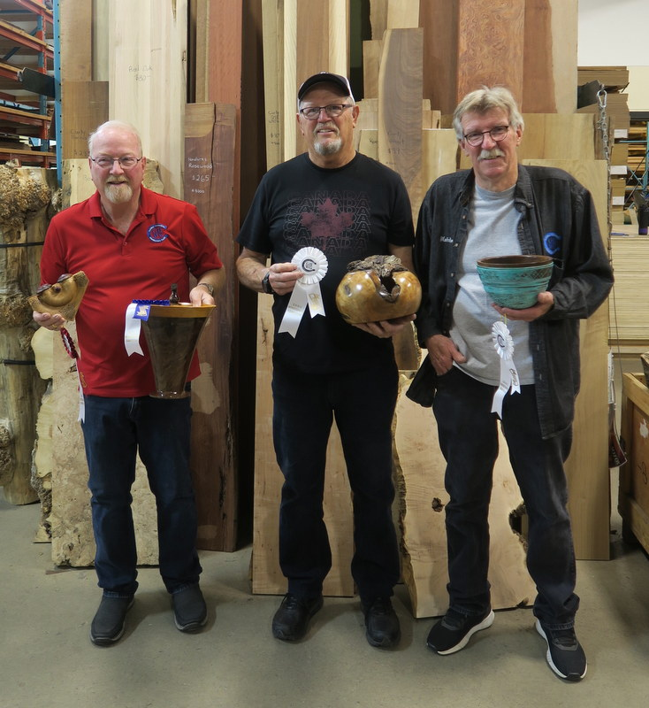
1st & 2nd : Keith Robinson
3rd : Don Svob & Malcolm Cumming

Slide 15
SEGMENTED

Slide 16
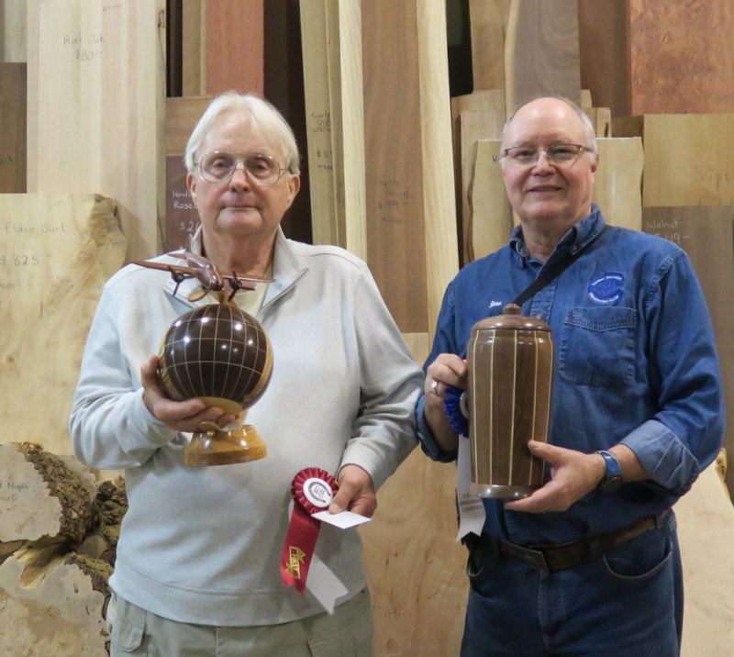
1st : Maurice Solar
2nd : Jim Wright

Slide 17
MOST PROMISING NOVICE

Slide 18
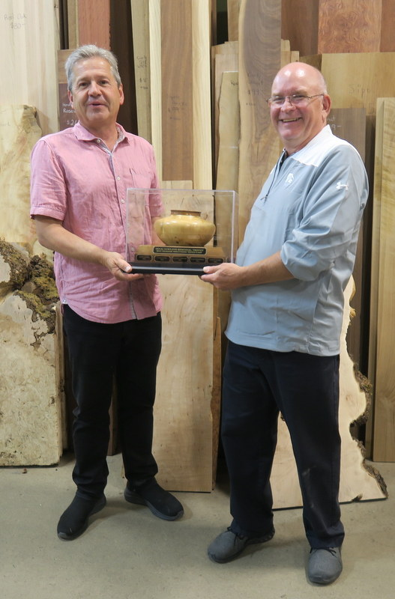
Most Promising Novice trophy presented to
Ed Erl by Keith Dunham

Slide 19
BEST IN SHOW

Slide 20
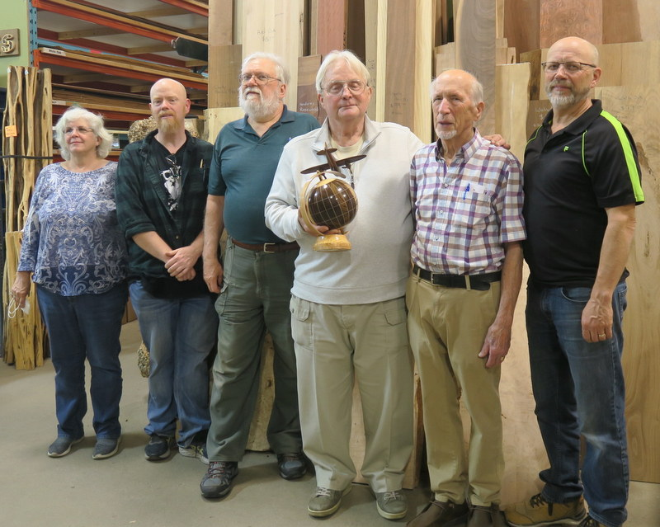
Best in Show awarded to Maurice Solar
by judges Andrea Perego, Chris Arcand, Mike Sheppard,
John Hordyk Sr and Mel Hordyk

